Slide 1
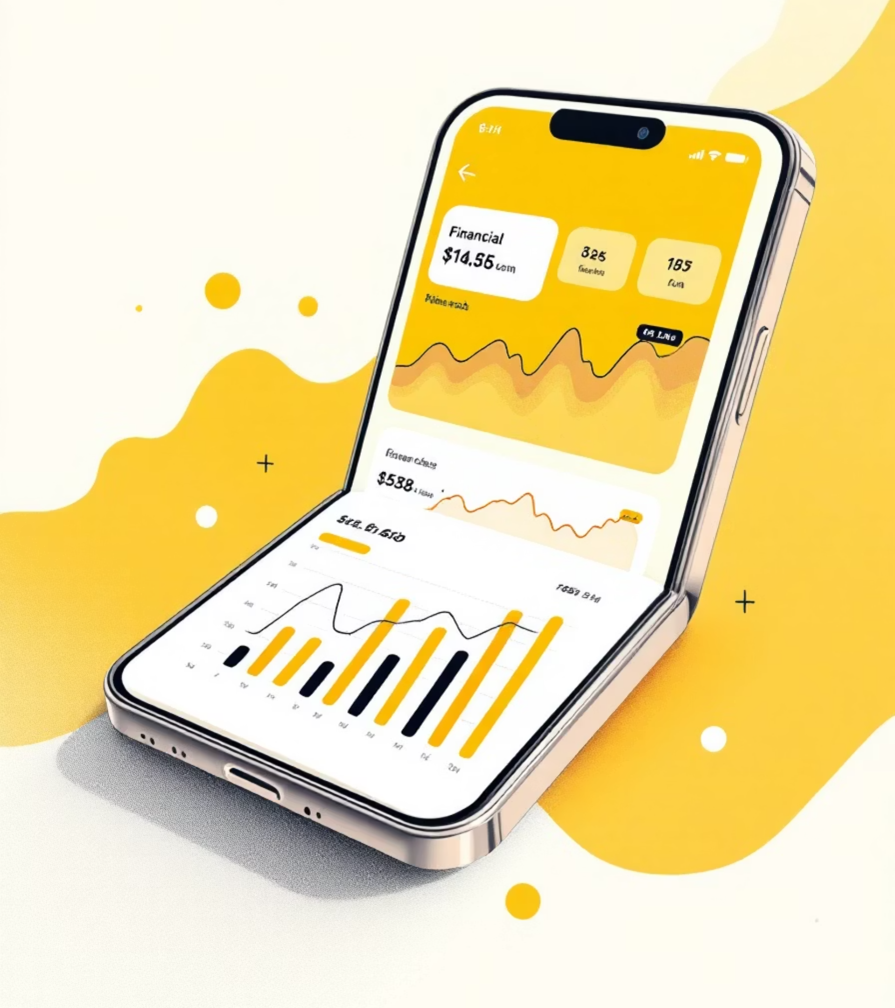
FinWise – AI Finance Coach
UI/UX Design Project
Sravani Pati
CPSC 8740 – AI-Receptive Software Development
Fall 2025

Slide 2

Project Overview
Purpose: To design an AI-powered finance app that helps users track expenses, set savings goals, and receive intelligent financial insights in a clean and user-friendly way.
Key Objectives:
Simplify personal finance management using AI-driven guidance.
Create an interface that feels intuitive, modern, and motivational.
Enable users to interact with an AI finance coach (FinWise) that provides real-time tips and insights.
What We Did:
Designed the complete UI/UX flow using Figma, assisted by ChatGPT.
Created low-fidelity wireframes to define structure and user flow.
Developed high-fidelity prototypes enhanced with AI plugins (iCharts, Forms) for realistic data visualization and goal tracking.
Ensured accessibility, responsiveness, and visual consistency throughout the design.

Slide 3



Research & Planning
Before designing FinWise, we researched existing finance apps to understand what works well and what frustrates users. Our goal was to identify gaps in usability, personalization, and engagement — and design a smarter, AI-driven solution.
Existing Apps Research
Pain Points Identified
User Needs
Analyzed Mint, YNAB, and PocketGuard to understand current market solutions
Complex design and lack of personalization were key user frustrations
Planning process focused on understanding what users truly need from a finance app

Slide 4
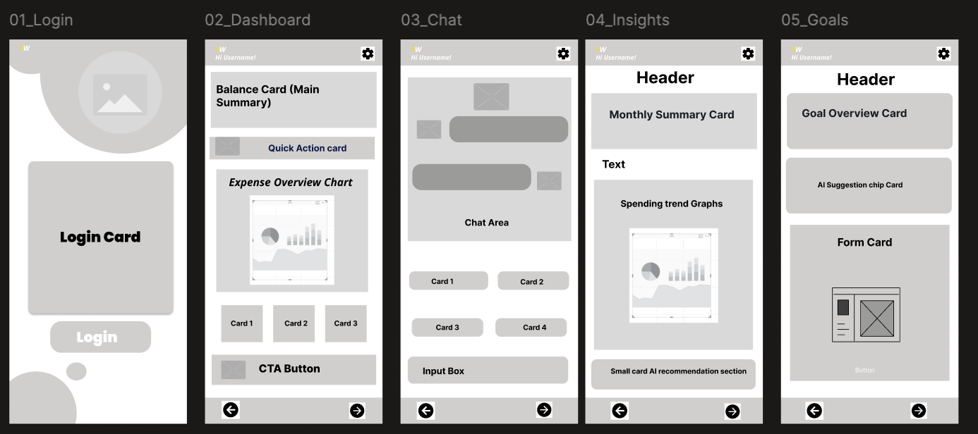
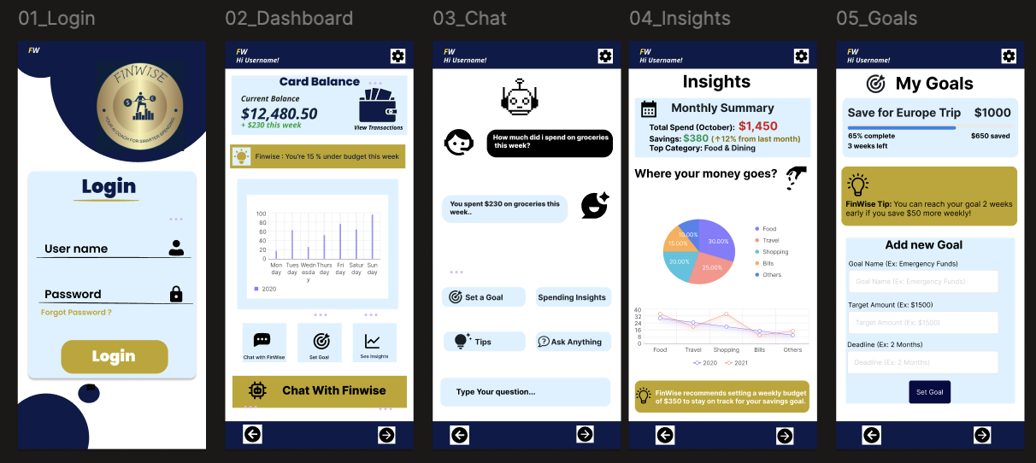
Design Process
The design process for FinWise focused on clarity, user flow, and visual consistency from the earliest sketches to the final prototype.
01
Low-Fidelity Wireframes
Grayscale layout screens to establish structure
02
High-Fidelity Prototypes
Final FinWise design with polished visuals
03
AI-Assisted Design
Figma AI features and ChatGPT assisted in layout and idea generation

Slide 5



AI Tools Used
AI tools played a key role throughout the creation of FinWise by enhancing creativity,
speeding up the design process, and improving overall accuracy.
ChatGPT
Figma Plugins
AI Suggestions
Design guidance & content
iCharts, Forms → automated charts and goal forms
Color & layout suggestions

Slide 6
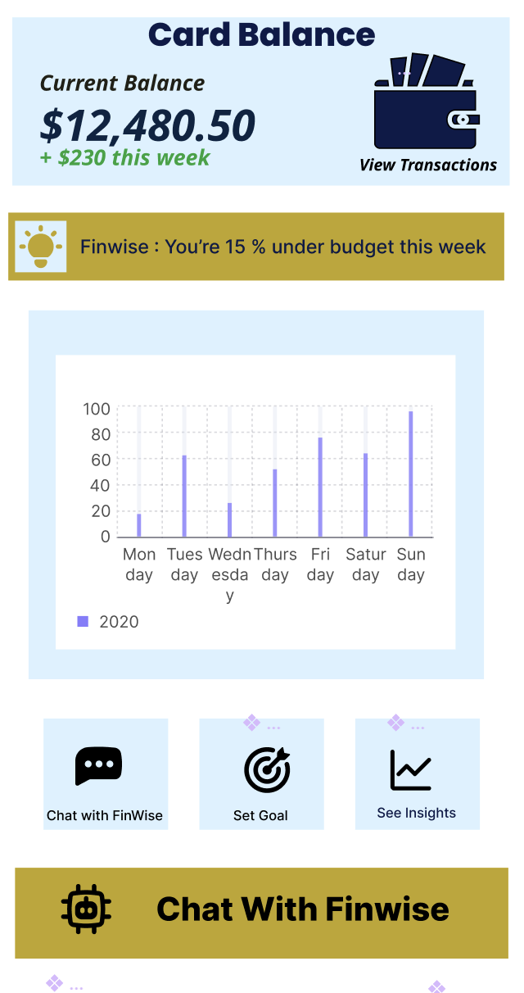
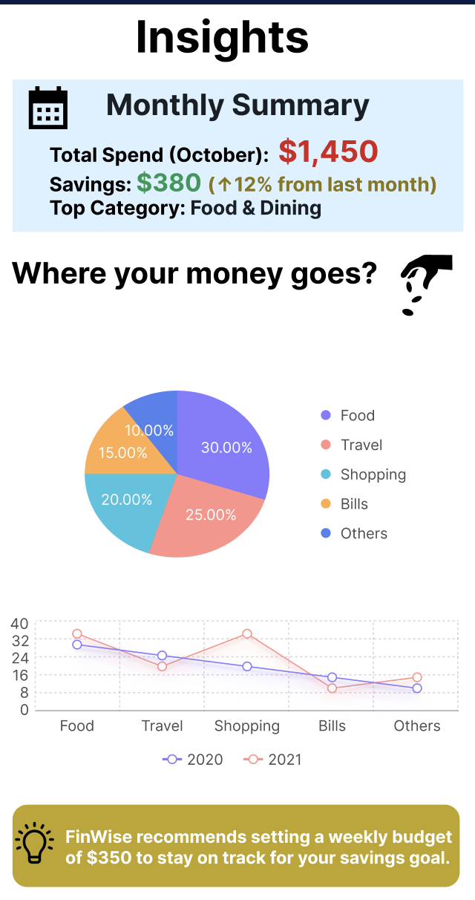
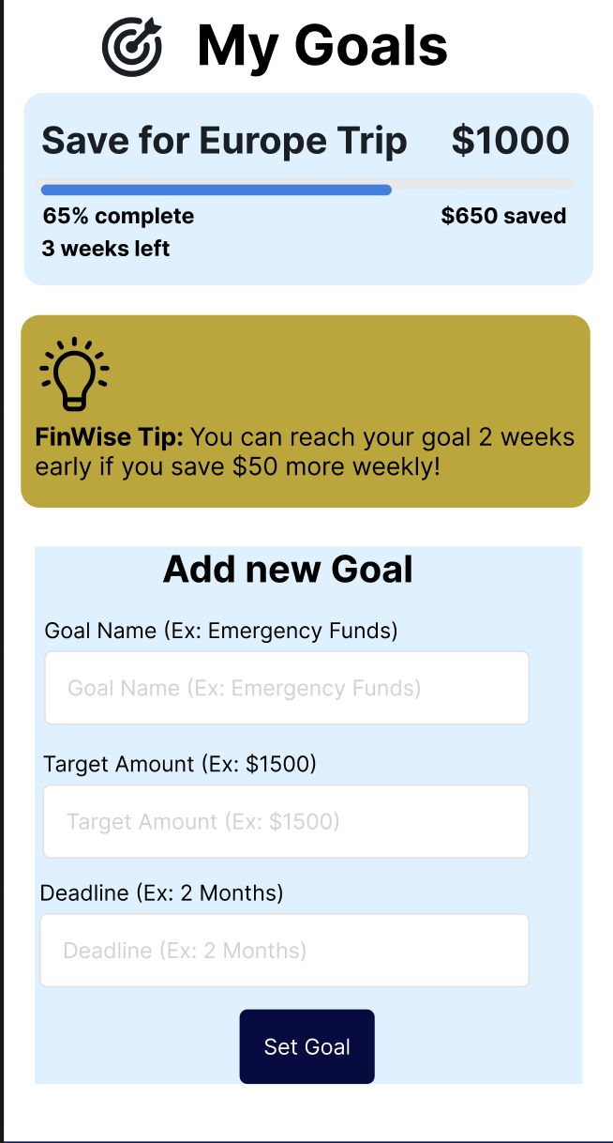
Final Prototype Features
The final FinWise prototype focuses on making finance management simple, intelligent, and visually engaging.
Smart Dashboard Shows real-time balance and weekly spending charts with AI-powered insights that help users understand their finances.
AI Assistant A friendly chat feature that guides users with personalized tips, spending analysis, and goal suggestions.
Goal Tracker Helps users set and track savings goals with clear progress visuals and motivational AI reminders.
Spending Insights Displays visual summaries of monthly expenses, helping users quickly spot patterns and make better financial decisions.
Design Highlights Created in Figma using AI tools for layout, color harmony, and interactive elements that make the experience smooth and consistent.
Visual representation of spending patterns
Progress bar with AI suggestions

Slide 7
Outcomes & Reflection
AI greatly improved the efficiency and creativity of the FinWise design process. It helped build user-centered layouts, enhance visual flow, and speed up decision-making. The final prototype delivers a seamless, intelligent experience that simplifies financial management while keeping users engaged.
Key Achievements
Future Enhancements
AI improved design efficiency and creativity
Real-time data integration
User-centered results achieved
Predictive analytics capabilities
Streamlined design process
Enhanced personalization features

